Slide 1

Introduction to Three Phase System
Md. Tariqul Islam
Notes:
NOTE:
To change the image on this slide, select the picture and delete it. Then click the Pictures icon in the placeholder to insert your own image.

Slide 2
Learning Outcomes:
After the ending of the lesson, students will be able to know,
About Single phase, Two phase and polyphase system.
The difference between single phase, two phase and three phase systems
The characteristics of three phase system
The advantages of three phase system over single phase system
About balance and unbalance system
About the procedure of determining phase sequences of a system

Slide 3
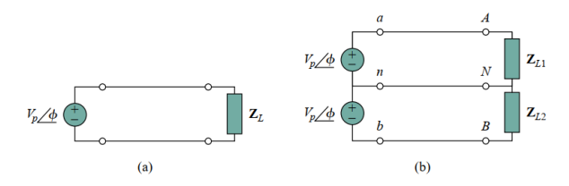
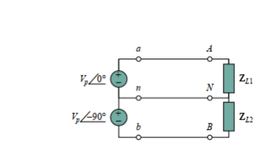
Single Phase Vs Two Phase
Single Phase System
Two Phase System
System has only one phase angle
The magnitude of the sources are same or different
The phase difference between each sources are zero
System has two phase angles
The magnitude of the sources are same or different
The phase difference between each sources are 90 degrees
Fig. 1. Single-phase systems: (a) two-wire type, (b) three-wire type
Fig. 2. Two-phase systems three-wire type

Slide 4
Question Session_1
Only for Three Students

Slide 5
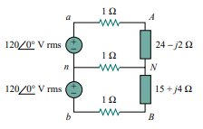

Question Session
Which kind of system has shown in the following figure?

Slide 6
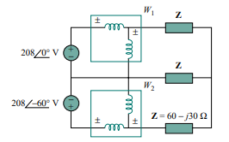
Question Session
Which kind of system has shown in the following figure?

Slide 7
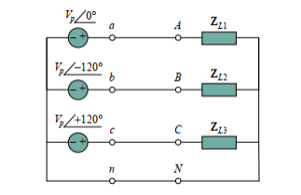
Three Phase System
It has same or different amplitude but same frequency
out of phase with each other by 120◦
Fig. 3 Three phase four wire system

Slide 8
Advantages of Three Phase System
First, nearly all electric power is generated and distributed in three-phase, at the operating frequency of 60 Hz (or ω = 377 rad/s) in the United States or 50 Hz (or ω = 314 rad/s) in some other parts of the world.
When one phase or two-phase inputs are required, they are taken from the three phase system rather than generated independently.
The instantaneous power in a three-phase system can be constant (not pulsating). This results in uniform power transmission and less vibration of three-phase machines.
for the same amount of power, the three-phase system is more economical than the single-phase amount of wire required for a three-phase system is less than that required for an equivalent single-phase system.

Slide 9

Polyphase System

Slide 10
Phase Sequence Calculation
Phase Sequence
Positive Sequence or abc sequence
Negative Sequence or acb Sequence

Slide 11
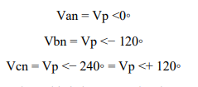
Mathematical Expression for Positive Sequecnce
where Vp is the effective or rms value

Slide 12
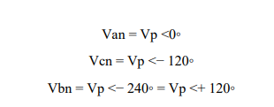
Mathematical Expression for Negative Sequence
where Vp is the effective or rms value

Slide 13
Determining Procedure of Phase Sequence
Step_2
Step_1
First we have to take Van as reference then rotate in clockwise direction to find the phase sequence
We have to draw the vector diagram at first

Slide 14
Mathematical Problem

Slide 15

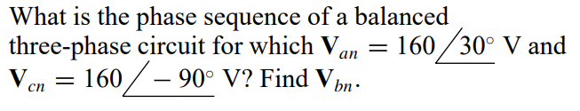
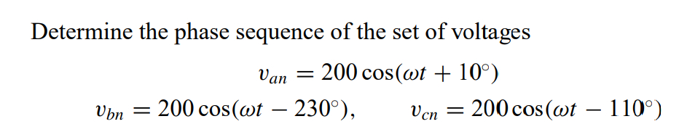
Problem_1

Slide 16
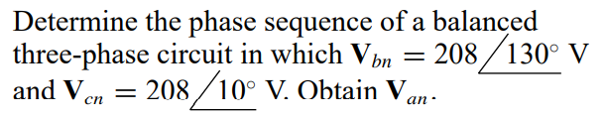
Problem_2

Slide 17
Question Session_2
Only for Two Students

Slide 18
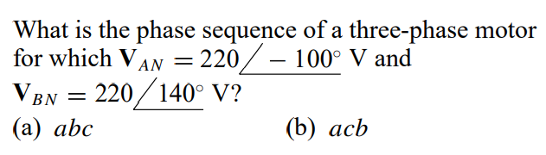
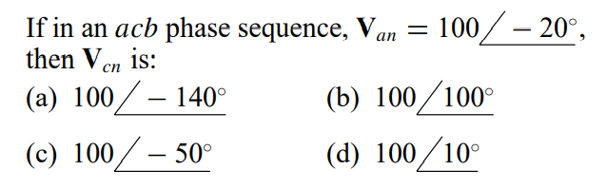
MCQ questions

Slide 19
Ready for Group Study
If it is possible, please turn on your camera

